Slide 1
ThunderGlide Motors Sales Analysis Project
Team Lead
Amal Mohamed Nawar

Slide 2
Business Need
ThunderGlide Motors’ sales team identified the need for a comprehensive analysis of sales data spanning the years 2003, 2004, and the first two quarters of 2005. Without clear insights into market trends and customer preferences, there was an increased risk of missing potential investment opportunities and failing to align product offerings with consumer demand.
Key Finding
Increase promotional activities in specific regions. By targeting specific regions with tailored marketing campaigns, ThunderGlide Motors can raise brand awareness, boost product visibility, and drive up sales for underperforming products.
Value Proposition
The project focuses not only on overall sales but also delves into region-specific performance and product-level insights. By analyzing which products performed well in specific regions, the project can offer tailored strategies for various markets, making it more precise and impactful.

Slide 3
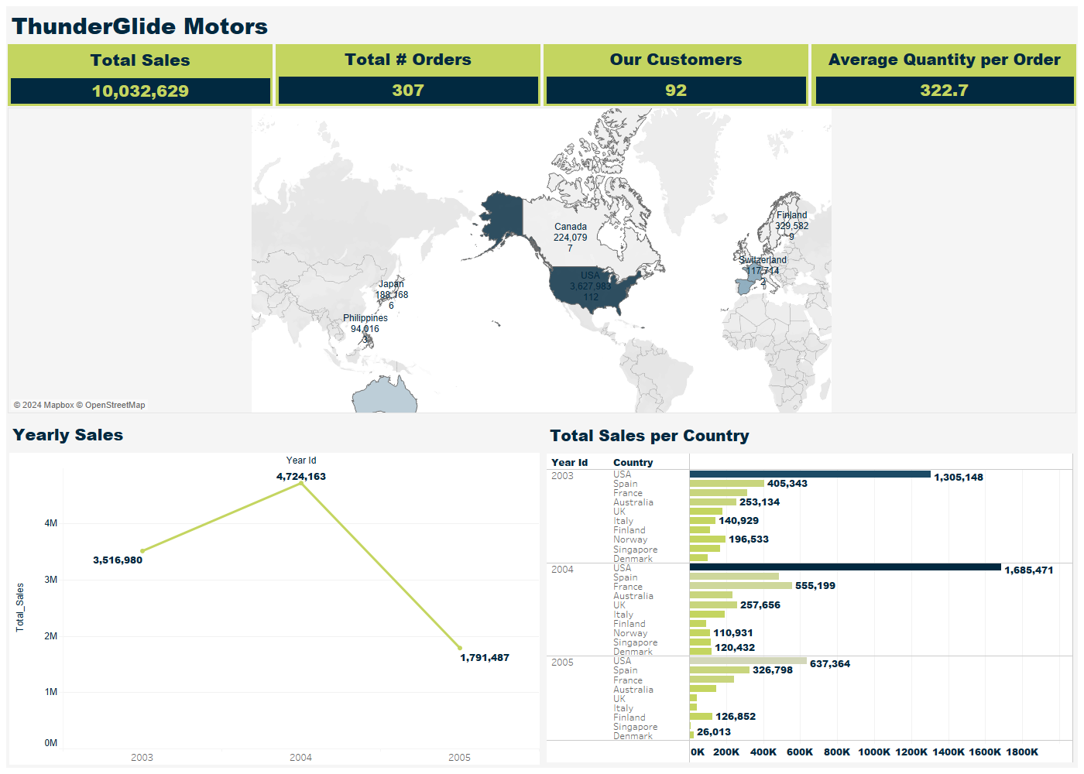

Slide 4

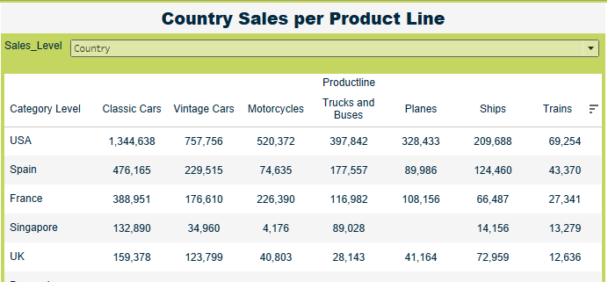
The project focuses not only on overall sales but also delves into region-specific performance and product-level insights. By analyzing which products performed well in specific regions, the project can offer tailored strategies for various markets, making it more precise and impactful.

Slide 5
Data Structure Shape of Data: The dataset consists of 2,823 and 18 columns. Temporal Data: The order date, Month_ID, Qtr_ID, and Year_ID features enable time-based analysis of sales performance and trends. Order number : Order ID Quantity Ordered : the quantity ordered for each product Price Each : Price Per Product Sales : Quantity Multiply the Product Price Order Date : Order Submitted Date Status : Order Status Qtr_id : Quarter Number of the Year Month_id : Month Number Year_id : Year MSRP : Manufacturer Selling Recommended Price Product Code : Represent The Id Identify for each Product Deal Size : How Big, Medium, Small The Deal Can Be Categorized.

Slide 6
Tools & Languages Used Data Extraction and Cleaning: Python (Pandas, Numpy) Data Exploration and Analysis and Forecasting: Python (Pandas, Numpy, Matplotlib, Scikit-learn), Microsoft SQL Server Data visualization: Tableau

Slide 7

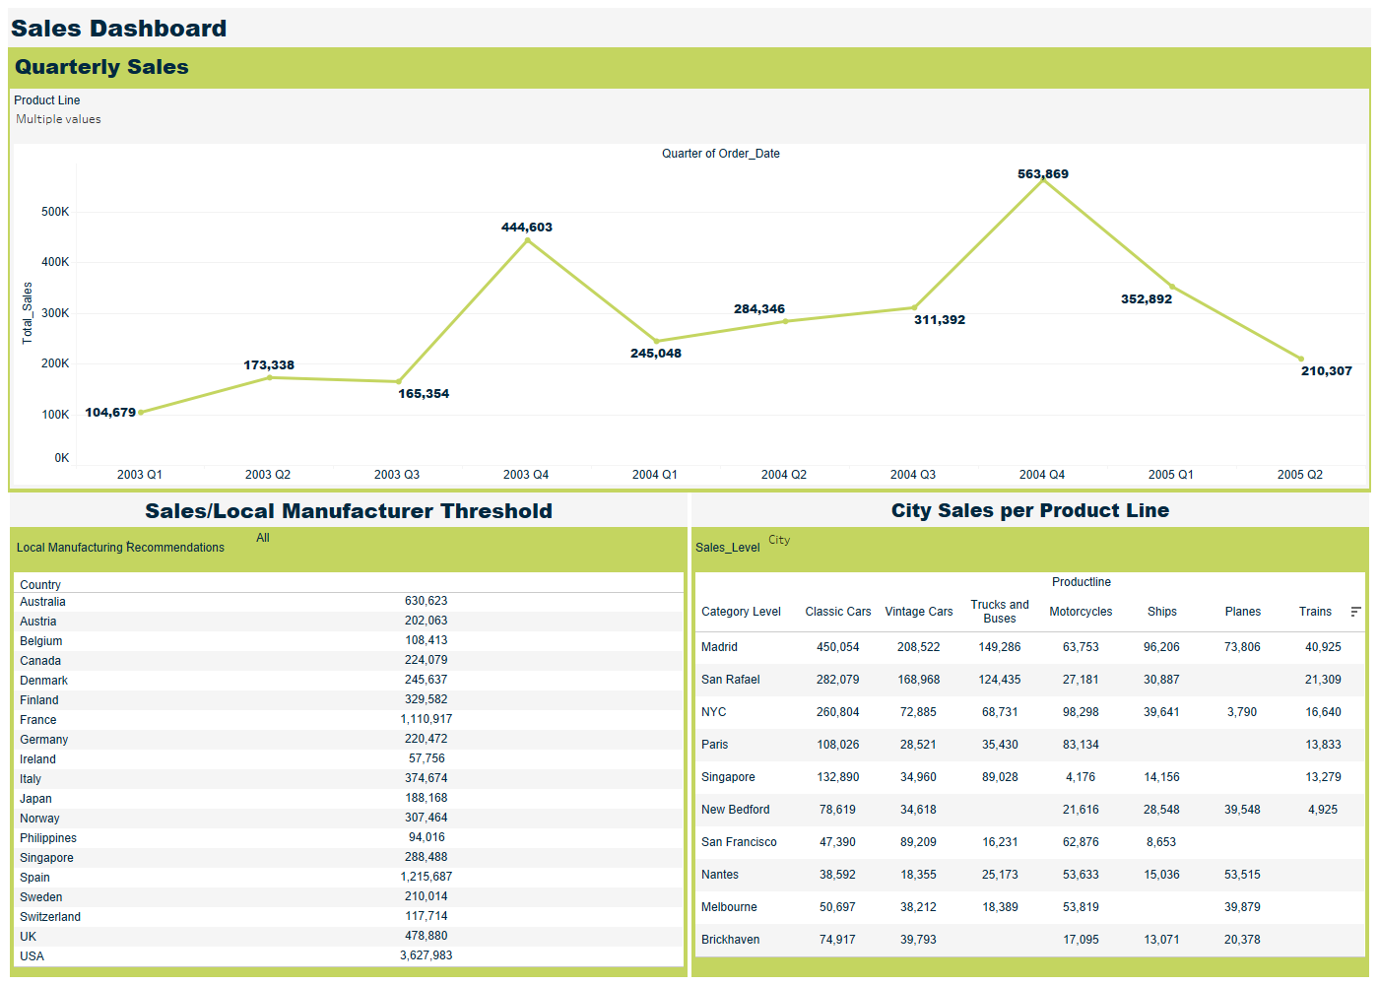
Our best seller product lines are the classic cars and vintage cars comes in the second place, with 39.07% and 18.97% contribution to the total sales.

Slide 8
Amal Mohamed Mohamed Abdelrazek: Team Leader and Tableau Visualization Developer
Nour Elhuda Mahmoud : Data Initial Analysis and Exploration (SQL Script Developer)
Esraa Bahaa Abdelrahem:
Data Cleaning, Preprocessing and Governance, Reporting (Python Data Cleaning Script Developer).
Shymaa Ahmed: Business Questions Designer and SQL Queries Designer.
Aya Ibrahim Ramadan:
Deep-dive Data Analysis and Forecasting (Python Script Developer).
Salma Medhat Mohammed: UX Designer
Eslam Sleman Mohamed: UX Designer

Slide 9
First Step Dataset was extracted from the company’s sales database for the past three years. Second Step Data cleaning and preprocessing was conducted using python and pandas. Incomplete and null sales data was resolved through careful data cleaning and validation processes. Delivered: 30/9/2024 Third Step Data initial exploration was conducted using Microsoft SQL Server. Delivered: 10/10/2024 Fourth Step Deep – dive data analysis and sales forecasting was performed using time-series models, leveraging historical data to project future trends. The analysis focused on customer segmentation, product performance, and regional sales patterns. Delivered: 19/10/2024 Fifth Step Data Visualization was conducted using Tableau using SQL Server data source. Delivered: 20/10/2024

Slide 10
Q&As

Slide 11
Thank You

